Slide 1
Viewing Geometry for a Simple Ray Generator from a 3D Eye Point
Avoids OpenGL projection setup.
(Thanks to Andrew Glassner)
Geometric Situation:
Know:
Eye world coordinates: E
Viewing vector direction: C (implies viewing distance is |C| )
Up vector: U
Field of view half angles: θ and φ
Output is a screen midpoint and two vectors used to iterate over the raster positions on the target NDC space.
We’ll compute the world coordinates of any point P in the NDC space.

Slide 2
Simple Viewing Geometry
P=(s_{x},s_{y})
(1,1)
V
M
H
φ
B
U
C
(0,0)
θ
A || H
B || V
Screen coordinates are NDC
V
E
A

Slide 3
Algorithm for Required Vectors and P
A ← C × U (be sure this is well defined)
B ← A × C (B is now in the correct plane)
M ← E + C (now have midpoint of screen)
H ← (A |C| tan θ) / |A| (rescale A to H)
V ← (B |C| tan φ) / |B| (rescale B to V)
Given the origin M as shown, any point in NDC is (s_{x}, s_{y}) [0 ≤ s_{x} ≤ 1; 0 ≤ s_{y} ≤ 1)]
E.g., if frame buffer is 320 pixels wide by 240 pixels high, then (50, 75) would map to (s_{x}, s_{y}) = (50/319, 75/239).
P ← M + (2s_{x} − 1) H + (2s_{y} − 1) V
The ray equation is thus:
R ← E + t(P − E) / |P − E|
(ray direction D is normalized P − E)
So just iterate this for each pixel (integer) coordinate pair.

Slide 4
Colors Computed While Unwinding the Recursion
For each ray-traced pixel:
Know surface that was hit (if any);
Know which point lights are visible from shadow rays;
Apply local illumination model at hit surface point.
Get shadows “for free”.

Slide 5
Feeds the LOCAL Illumination Formula
Color (r, g, b) reflected at the visible point =
ambient light + (for each light source ray that is not occluded) light color × [diffuse component × surface color +
specular reflection component]

Slide 6
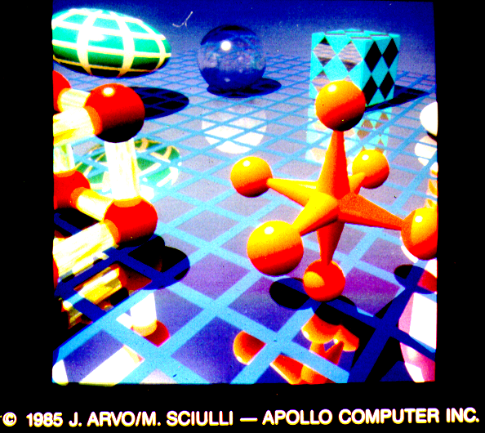
“Typical” Ray Traced Image

Slide 7
Mirror Reflection
R_{i} = Incident ray direction (unit vector) to some surface point P.
R_{r} = Reflected ray direction (about P).
R_{r} = R_{i} – 2 N (R_{i} • N)
N
R_{r}
R_{i}
φ
φ
Mirror Surface
P

Slide 8
Refracted Ray Geometry: Index of Refraction η and Snell’s Law
I = incident ray
N
I
Refracting
surface
= Index of refraction
of substance 1
= Index of refraction
of substance 2
Snell’s Law:
(I and T are coplanar)
-N
T = transmitted ray
η =
1.0 vacuum
1.00029 air at sea level
1.31 ice
1.333 water 20°
1.52 crown glass
1.66 flint glass
2.42 diamond
An index of refraction that varies by wavelength causes dispersion (e.g., a prism breaks white light into colors).

Slide 9
Computing the Refracted Ray
One can derive the vector T:
Notice that the √ may become imaginary; in this case there is no refraction at all.
This is called the critical angle .

Slide 10
Refraction and the Critical Angle
No refraction at the critical angle
N
Refracting
surface
I
T
-N

Slide 11
Refraction and the Critical Angle
Internal (mirror) reflection beyond the critical angle
N
Refracting
surface
T
I
-N

Slide 12
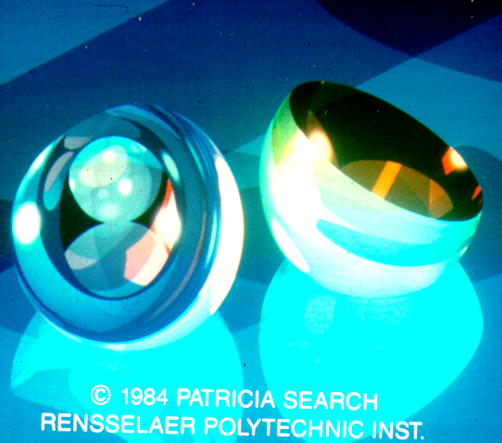
Complex Images from Reflection and Refraction

Slide 13
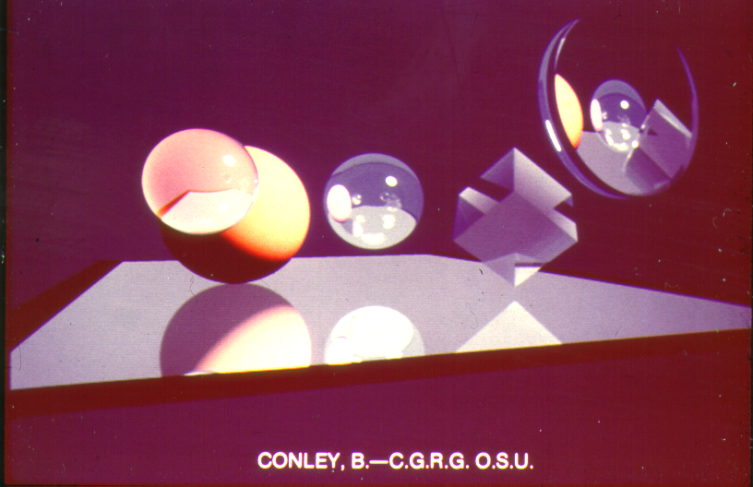
Ray Tracing with Several Ray Effects

Slide 14
Recursive Ray Trace Pseudo-Code: Some Definitions
rgb LtSource [m]; {color of light source (m of them)}
rgb BackgroundColor; {background color}
rgb ambient; {ambient light color}
int MaxDepth; {maximum recursion depth of ray tree}
rgb color; {returned color}
ray R, D, P, …; {rays}
vector N; {surface normal}
vector L[m]; {list of m light source locations}
object objects [n]; {list of n objects in scene}
rgb C[n]; {color for each object}
float Kd [n]; {diffuse reflectivity factor for each object}
float Ks [n]; {specular reflectivity factor for each object}
float Kn [n]; {specular Phong exponent for each object}
float Kt [n]; {transmittance for each object}
float Ka [n]; {ambient factor for each object}
float Kr [n]; {index of refraction for each object}

Slide 15
The Rays are Generated in the Outer Loops − (Refer to “Simple Viewing Geometry”)
for pixel(x,y) column x = 0 to width-1
for pixel(x,y) row y = 0 to height-1
begin
P = M + (2*x/(width-1) − 1)*H + (2*y/(height-1) − 1)*V;
D = (P − E) / |P − E|;
TraceRay(E, D, 0, color);
pixel(x,y) = color
end

Slide 16
Ray Tracing Algorithm
procedure TraceRay(start, direction: vectors;
depth: integer; var color: rgb);
ray ReflectedDirection, RefractedDirection, TransmittedDirection;
rgb spec, ReflectedColor, refr, RefractedColor, trans, TransmittedColor;
begin
if (depth > MaxDepth) then
color = BackgroundColor
return;
{intersect ray with all objects and find intersection point (if any) on object j that is closest to start of ray; else return nil}
IntersectionPoint = RayIntersect(objects, j);
if j == nil
then if (ray is parallel to any of the m light directions, say k)
then color = LtSource[k]
else color = BackgroundColor
else {have first intersection with object j}

Slide 17
begin
(compute object j normal N at IntersectionPoint)
if (Ks[j] > 0) then {non-zero specular reflectivity}
{Compute direction of reflected ray}
TraceRay(IntersectionPoint, ReflectedDirection,
depth+1, ReflectedColor);
spec = Ks[j] * ReflectedColor
else spec = 0;
if (Kt[j] > 0) then {non-zero transmittance}
{Compute direction of refracted ray}
TraceRay(IntersectionPoint, RefractedDirection,
depth+1, RefractedColor);
refr = Kt[j] * RefractedColor
else refr = 0;

Slide 18
{do shadow rays}
if inside(ray, object[j])
then color =(0,0,0)
else begin {simple local reflectance model‡}
color = Ka[j] * ambient * C[j] + refr;
for i =1 to m
if ShadowRayUnblocked(IntersectionPoint, L[i]))
then color += LtSource[i] * (Kd[j] * C[j] * (N · L[i])
+ spec*(ReflectedRay(L[i], N,
IntersectionPoint) · E)^Kn[j]))
end
end
end
----------------------------------------------------------------------------------
boolean ShadowRayUnblocked(P1,P2): computes whether the ray from P1 to P2 is blocked by any object.
ray ReflectedRay(P1, PN,PO): returns the reflection of ray P1 about normal PN at point PO.
‡ Uses the Local Illumination model formula

Slide 19
Ray-Object Intersection Efficiency
Ray in world space coordinates: R = (R_{start_ws}, R_{direction_ws}).
Polygon mesh object P = {P_{j}} has numerous 3D vertices (j is large).
World coordinates of P are CP for some composite modeling transformation C from the scene graph.
Computing world coordinates of mesh object in the scene graph is very expensive and unnecessary!
Transform ray into mesh object definition space, find intersection (if any) and then transform any intersections back into world coordinates.
Works for other modeling types, too, such as surfaces, quadrics, volumes, and implicit functions: that means the intersection test can be done in a standard geometric position, which makes the math much nicer!

Slide 20
Intuition: Transform 3D Model from Object Space (OS) to World Space (WS) [O(object vertices)]
Object definition space (OS)
y
z
z
y
x
x
V
C = Modeling
Transformations
(but not viewing transformation)
Simple ray generation
In world space (WS)
C

Slide 21
More Efficient to Transform Ray into Object Space! [O(2)]
Object definition space (OS)
y
z
z
y
x
x
?
V
C = Modeling
Transformations
(but not viewing transformation)
Simple ray generation
In world space (WS)
C

Slide 22
Transforming Ray Back into Object Coordinates
Let C be the local object definition space (OS) to world coordinate space (WS) modeling transformation: {Model}_{ws} = C {Model}_{os}
Transform the WS ray’s origin R_{start_ws} and direction R_{direction_ws} to OS.
Origin is just R′_{start_os} = C⁻¹R_{start_ws}
How about R′_{direction_os}? Cannot just do R′_{direction_os} = C⁻¹R_{direction_ws}.
Endpoints of ray have equal translations, so transform both ends and subtract result. This is equivalent to just ignoring the translation component of C: R′_{direction_os} = (C*)⁻¹R_{direction_ws}
y
z
z
y
R′
C
x
x
R
WS OS

Slide 23
What About Mapping the Ray-Surface Intersection Back into the World Space?
If we do the ray intersection in OS we get an intersection parameter t_{os}; we need to have t_{ws} so we can compute the surface color, etc.
If we use normalized directions for rays then after
R′_{direction_os} = (C*)⁻¹R_{direction_ws}
|| R′_{direction_os} || may not be 1 (e.g., if C has scale factors ≠ 1).
So t_{ws} = t_{os} / ||R′_{direction_os}||
The intersection point in WS is:
P_{ws} = R_{start_ws} + t_{ws} * R_{direction_ws}
(C*)⁻¹
t_{os}
P_{ws}
P_{os}
R′
t_{ws}
C
R

Slide 24
Reality Check
Take an OS unit cube centered at the origin that is uniformly scaled by 2 into WS: its surfaces are in the planes x = ±2, y = ±2, and z = ±2).
Suppose a unit length WS ray with starting point (4, 0, 0) points straight at the x = 2 face of the cube. Trivially, we would expect t_ws = 2, because the cube's face is hit at (2, 0, 0).
Now transform the ray into OS: this entails scaling it by 0.5 (=1/2 = inverse of the cube’s WS modeling transformation). The transformed ray starts at (2, 0, 0) now, but is only half the length. But to reuse any ray-object intersection code, we re-normalize the ray to unit length.
The OS cube is centered at the origin, and its face is at (1, 0, 0). t_os = 1 because the ray starting point and cube face are only 1 unit apart.
But the ray WAS scaled from WS to OS therefore ||R_os|| = 0.5.
So then t_ws = 1/0.5 = 2, the right answer as per (#2).

Slide 25
Transform the Normal Back into the World Space
We still need the transformed normal from the object space intersection:
N_{ws} ≠ C N_{os}
So can’t just use C⁻¹!
Key is to transform the TANGENT plane…
Transformed shape;
Normals treated like
object points
Original shape;
Original normals
Transformed shape;
Correctly transformed normals

Slide 26
Transform the Normal Back into the World Space
Pick any vector V_{os} in the tangent plane: V_{ws} = C V_{os}
N_{os} ⊥ V_{os} so:
0 = N_{os}^{T} V_{os}
0 = N_{os}^{T} (C⁻¹ C) V_{os}
0 = (N_{os}^{T} C⁻¹) (C V_{os} )
0 = (N_{os}^{T} C⁻¹) V_{ws}
Since N_{ws} ⊥ V_{ws}
N_{ws}^{T} = N_{os}^{T} C⁻¹
(N_{ws}^{T})^{T} = (N_{os}^{T} C⁻¹)^{T}
N_{ws} = (C⁻¹)^{T} N_{os}
For
points
C
(C⁻¹)^{T}
V_{os}
N_{ws}
V_{ws}
For
normals
N_{os}
R′
R

Slide 27
Ray Tracing Efficiency Considerations
COST = X . Y . 2ª (m + 1) (2^{n} - 1) P
X = number of pixels horizontally
Y = number of pixels vertically
a = anti-aliasing super-sampling factor
m = number of (point) light sources
n = tree (recursion) depth
P = number of primitives tested for ray intersections
For example, if X=Y=1000, a=0, m=1, n=10, P=1000 then
COST ~ 2,046,000,000,000 ray-primitive intersection tests!
Clearly there must be a better way!

Slide 28
Ray Tracing Speed Ups
Extents (bounding boxes)
Spatial hierarchies (e.g., finding implicit function surfaces)
Spatial partitioning (PVC, BSP)
Item buffers
Reflection maps
Adaptive tree-depth control
Ray classification
...
In practice, ray tracing is not done in real-time (unless reflections are limited to one bounce, like environment maps)
There are good commercial software ray tracers.
There is a board (ART’s RenderDrive) to do limited types of ray tracing.
Ray tracing shaders can be cost effective for certain movie special effects.

Slide 29
Ray Tracing Summary
Ray-tracing provides “hard-edge” effects easily, including specular reflections, refraction, translucency and shadows from multiple light sources.
Global illumination gives better diffuse lighting. We’ll do this later.

Slide 30
Shade Computation
Models:
Diffuse or Lambert
Vertex color interpolation and Gouraud
Perfect specular
Phong: Glossy specular
Recursive ray tracing
MICROFACET
Empirical

